Slide 1

EDA Final Project Topic : Stroke Prediction Analysis
Team Members:
Meghana Boinpally
Raghav Chegu Shyam Kumar
Shefali Mahendra Luley

Slide 2
Dataset
Dataset consists of 11 attributes
Categorical:
gender: "Male", "Female" or "Other"
ever_married: "No" or "Yes"
work_type: "children", "Govt_job", "Never_worked", "Private" or "Self-employed"
Residence_type: "Rural" or "Urban"
smoking_status: "formerly smoked", "never smoked", "smokes" or "Unknown"
hypertension: 0 if the patient doesn't have hypertension, 1 if the patient has hypertension
heart_disease: 0 if the patient doesn't have any heart diseases, 1 if the patient has a heart disease

Slide 3
Dataset
Numerical:
age: age of the patient
avg_glucose_level: average glucose level in blood
bmi: body mass index
Target Variable :
stroke: Output[1: Patient had a stroke ,0: Patient didn't have a stroke]

Slide 4
Research Questions
Our project's aim is to visualize and comprehend the risk factors of stroke.
What are the attributes that are associated with stroke?
Can we perform Dimensionality reduction of this high dimension data by minimizing information loss
Will non-linear classifiers be more effective in predicting if an individual has a stroke or not?

Slide 5
Data exploration and cleaning
There are 4908 observations, 209 with stroke and 4699 without stroke.
There are 201 records in the BMI column consisting of "N/A".
The gender column consisting of just one record showcasing the "Other" gender.
As, this was just 4% of the entire data we removed it for better analysis.

Slide 6

Univariate Analysis

Slide 7

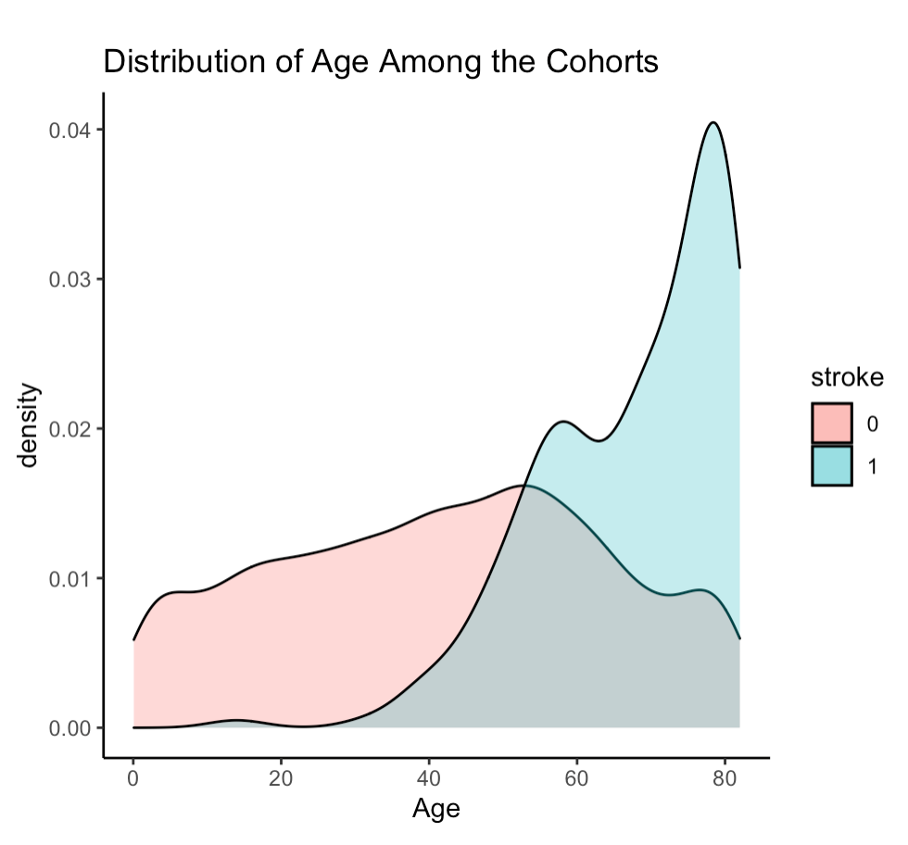
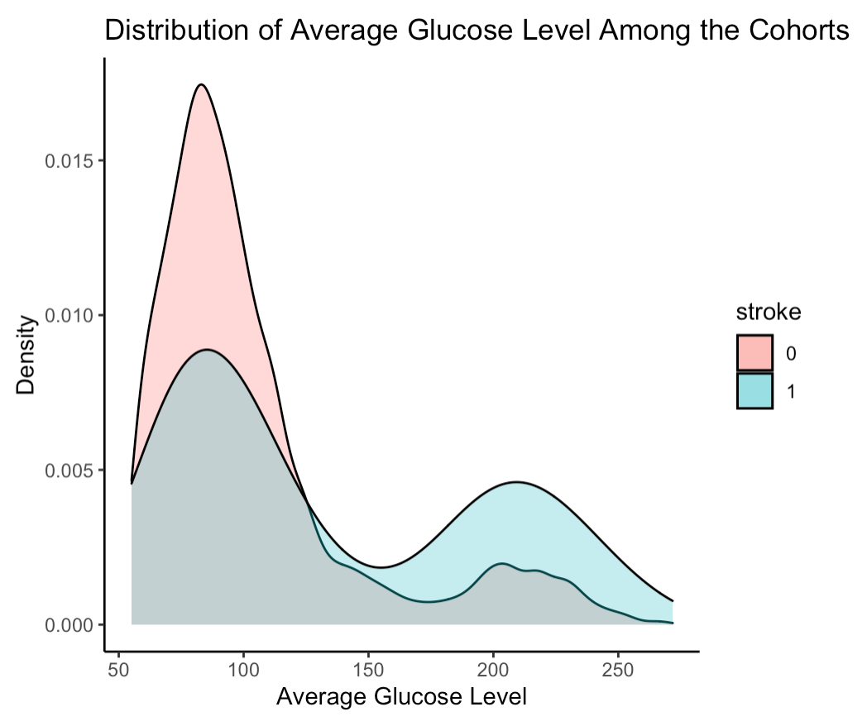

Elderly are at a higher risk of a stroke than the younger generation.
It can be observed that people who got stroke tend to have higher glucose levels.

Slide 8
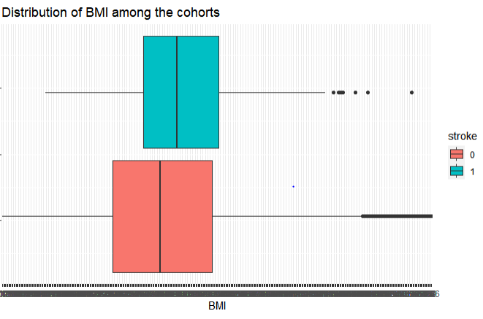
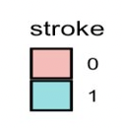
BMI
It can be observed that those who got stroke on an average have higher Body Mass Index (BMI).

Slide 9
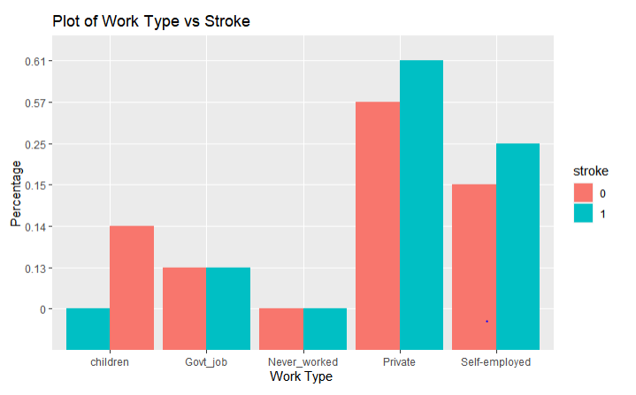
Work Type
There is a higher risk of stroke for those who are working especially in Private or are self- employed.

Slide 10
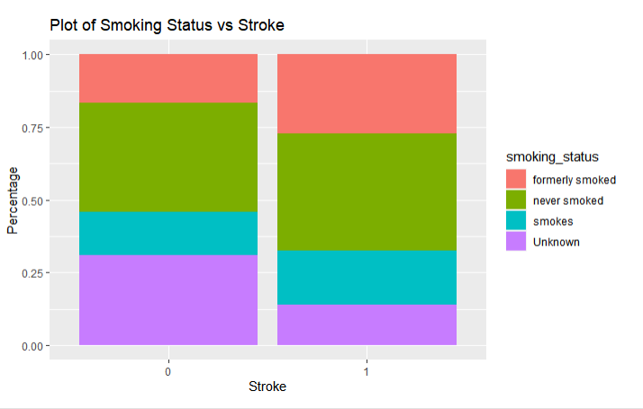
Smoking Status
It can be observed that people who are having a history of smoking tends to higher risk of stroke when compared to others.

Slide 11
Bivariate Analysis

Slide 12

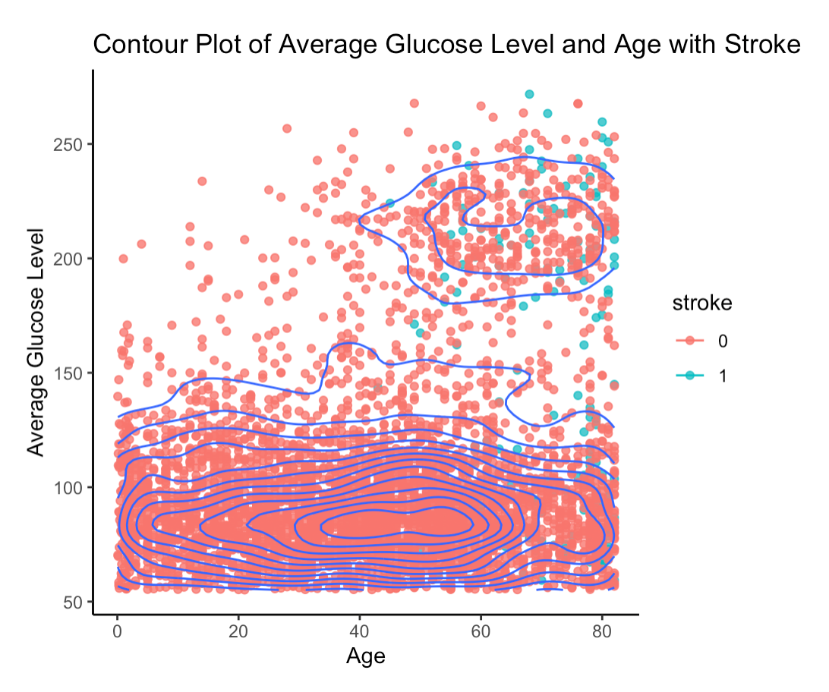
Bottom cluster appears to have lesser people with stroke than the Top Cluster.
We can infer that most people who do not have stroke have a lower average glucose level across all different ages.

Slide 13
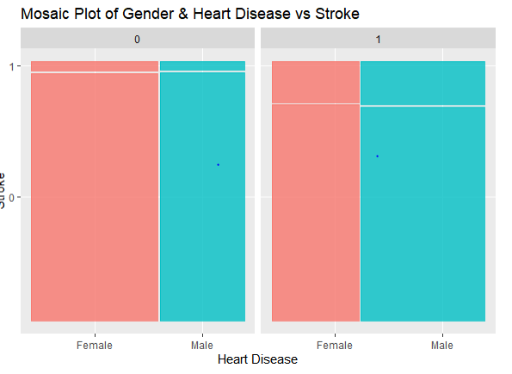
Deep Dive into Gender & Heart Disease
There is no change in the gender as the graph mirror each other.
It can be seen that there is a higher risk of stroke for those who have heart disease.

Slide 14
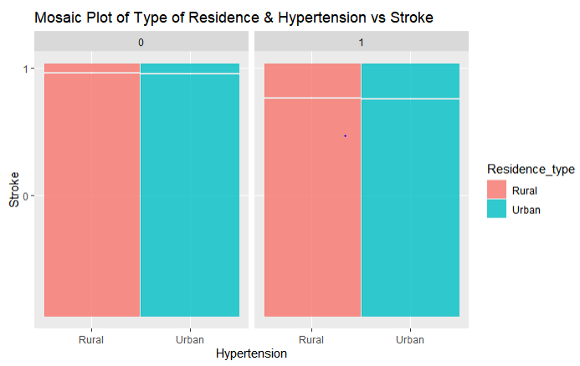
Deep Dive into Residence Type & Hypertension
Residence Type does not show any significant difference across Stroke.
It can be noticed that those who have hypertension, have a higher risk of stroke.

Slide 15
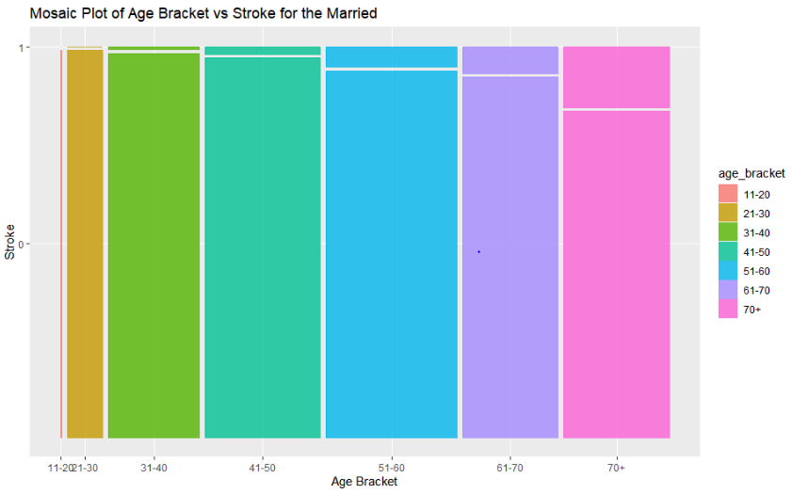
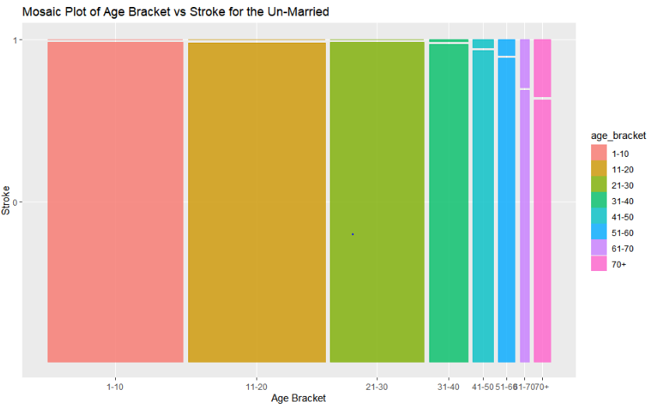
Does being Married influence Stroke?
From this graph we observe that being married is correlated to the age
Age has an effect on stroke not being married

Slide 16
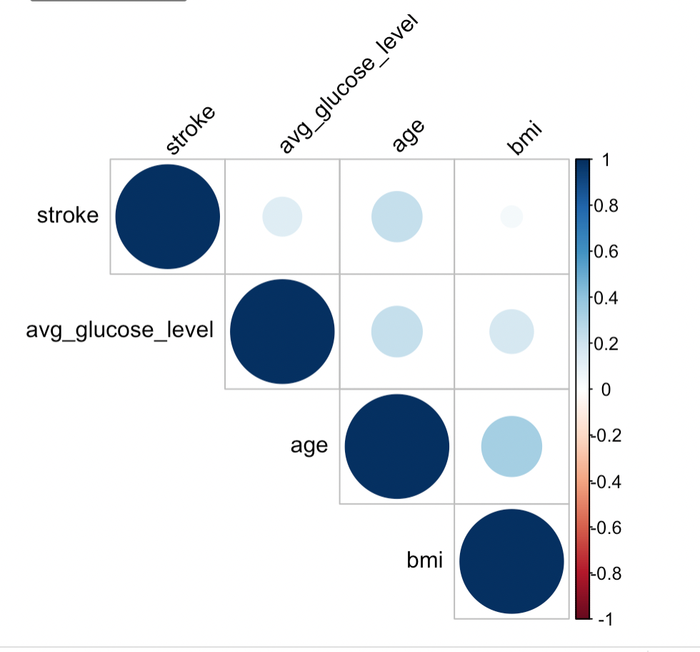
Correlation plot between continuous variables
Age and stroke are positively correlated.
Average glucose level is also correlated with stroke
BMI seems to be not correlated to having stroke at all.

Slide 17
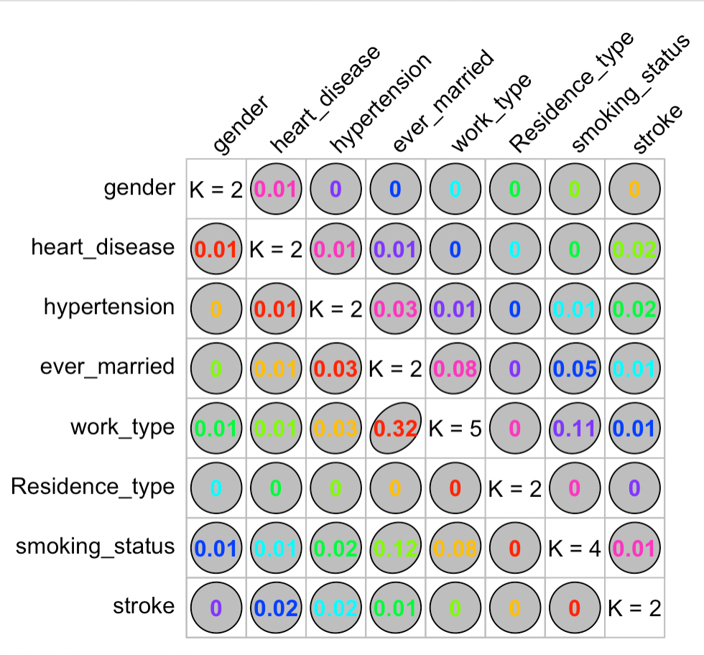
Association Analysis for Categorical Variables
Goodman and Kruskal’s tau measure
No variable is perfectly predictable from another variable.
The reasonable association seen in this plot is that between work_type and ever_married where the forward association is 0.32 and the reverse association is 0.08.

Slide 18
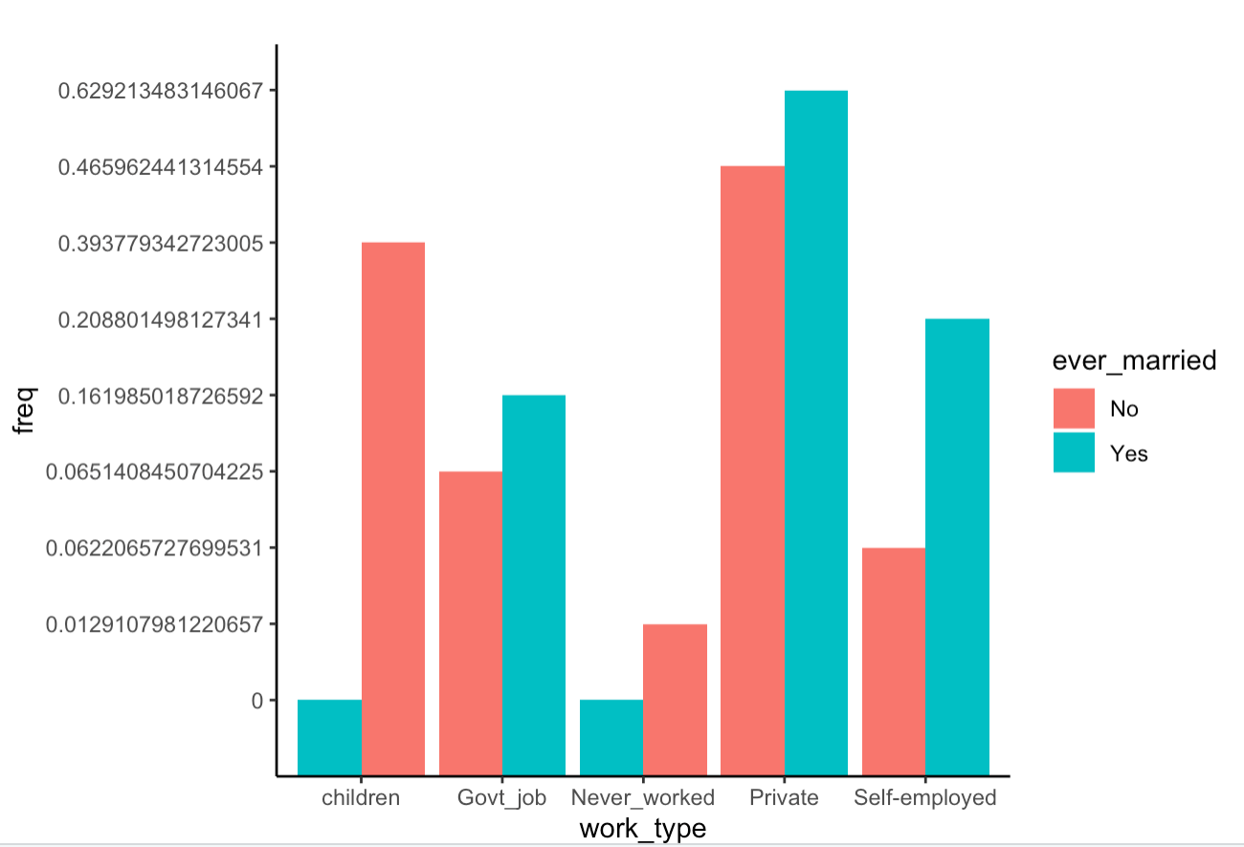
Association work_type and ever married
From this we can observe that children and never_worked were never married
One-way association

Slide 19
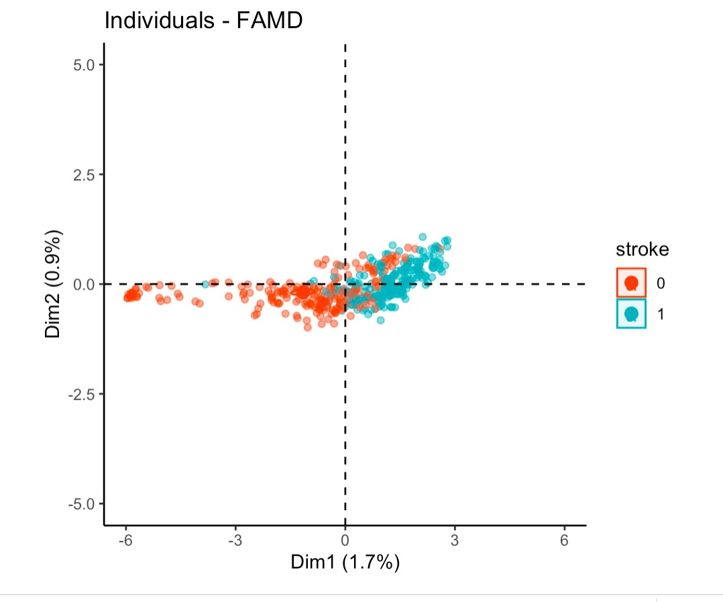
Attempting Dimensionality Reduction
Only a small percent of variation is represented by the principal components.
This suggests that there are not a lot of correlation among the variables, so we cannot significantly reduce the dimension
After Undersampling

Slide 20
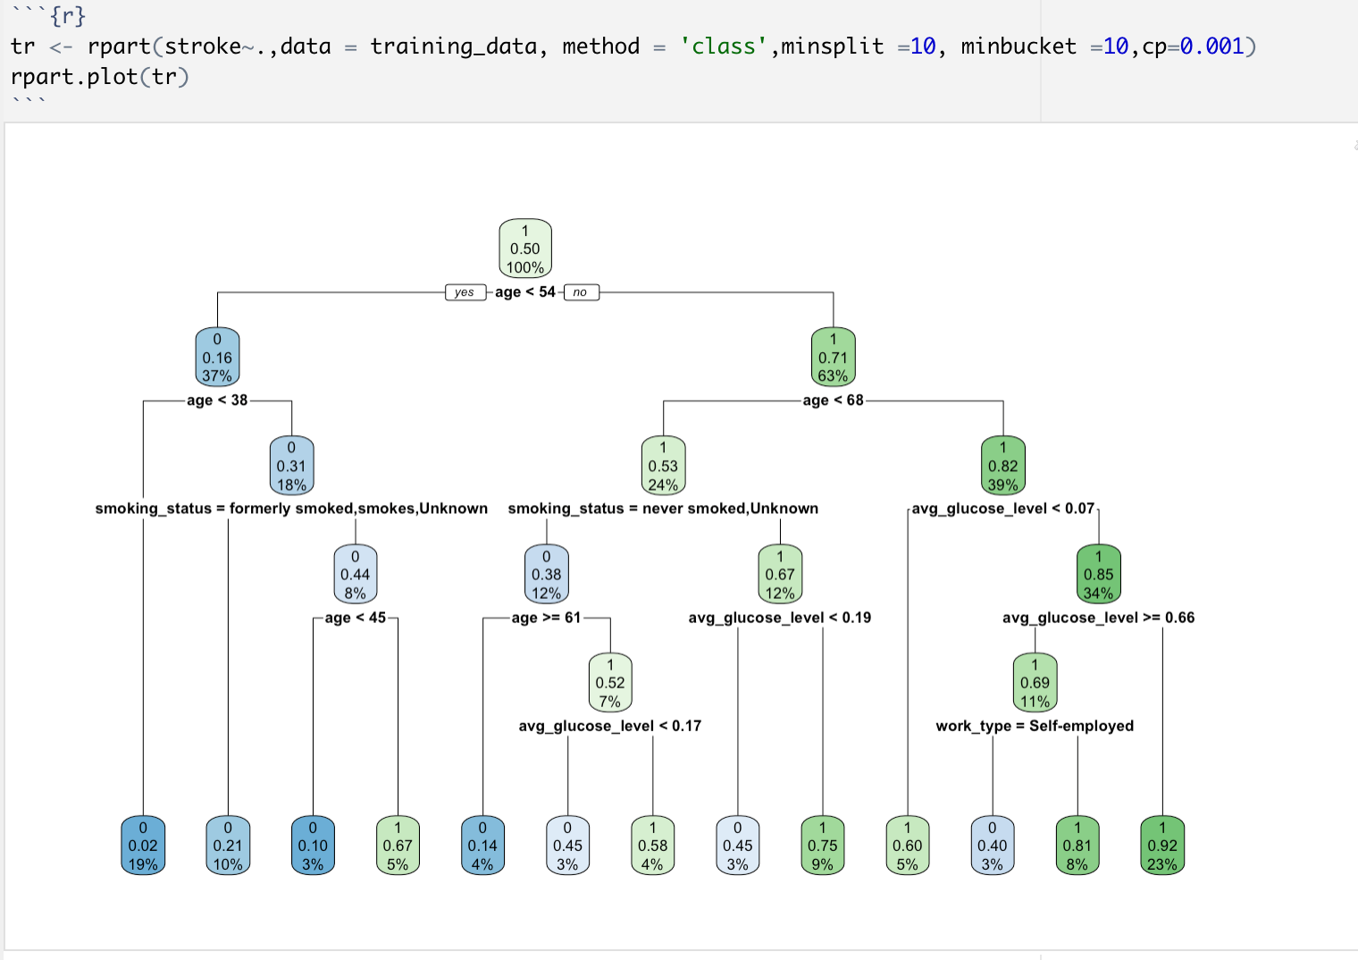
Non-Linear Classifier: Decision Tree
We have 50 percent of patients not having stroke.
The root node asks whether the age is less than 54. If it does, then the probability of having stroke is 16 percent.
If it doesn’t, then we go down to the root’s right child node . 63 percent are patients with age larger or equal to 54, and the probability of having stroke is 0.71
We keep on going down like that to understand how features impact the likelihood of having stroke.
After Undersampling

Slide 21
Limitations
One of the primary limitations we faced was dealing with a highly imbalanced data.
There could be other key factors affecting the stroke like cholesterol.
The data might not be a good representative of the population.

Slide 22
Future Scope
Better data acquisition such as a balanced data with other key features can help in giving better insights.
Implementation of this analyses in real-time environments and determining the severity of stroke.

Slide 23
Thank You

